Slide 1



GLOBAL ENERGY ENTERPRISES, INC.
Phil Daniel
Dusty Ramirez
Joseph Bentley

Slide 2
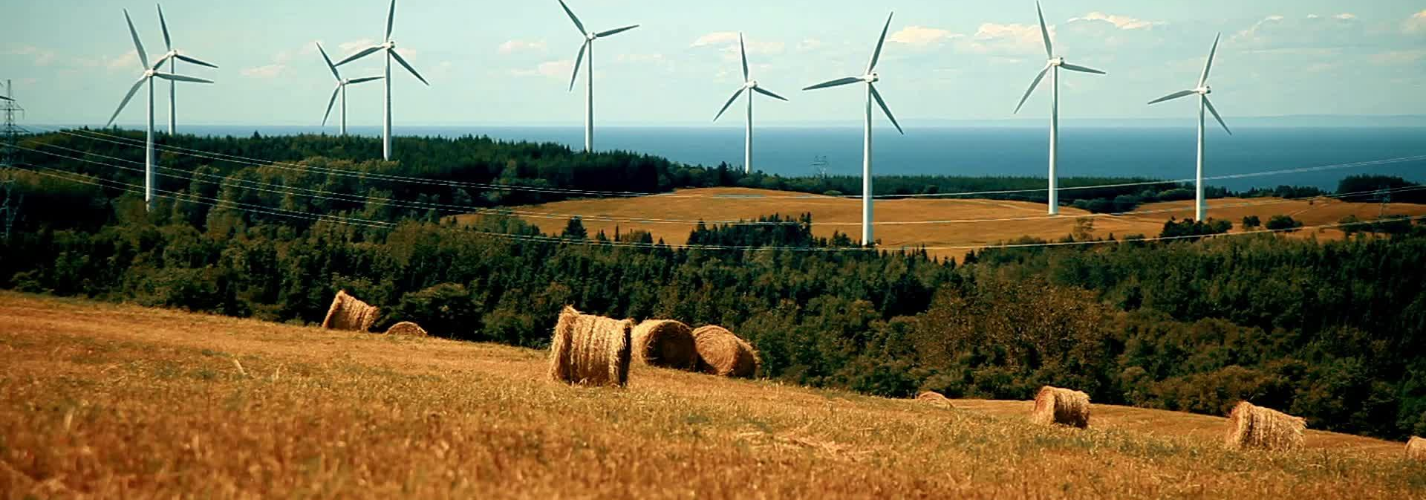
WIND ENERGY INDUSTRY ANALYSIS
WOW! Investment opportunity consult

Slide 3
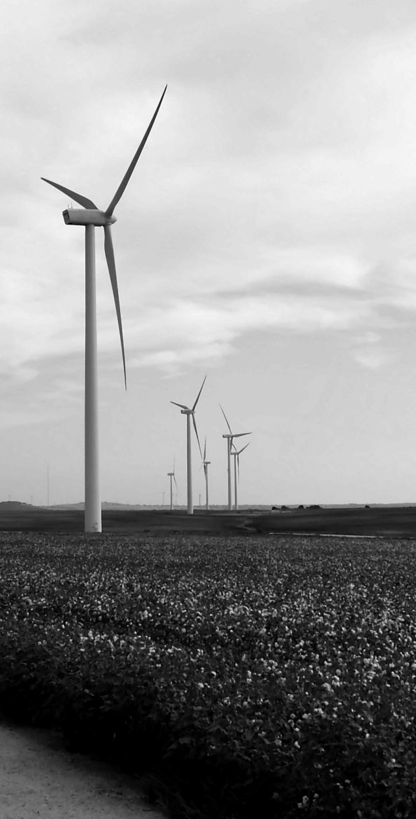
AGENDA
GLOBAL ENERGY MARKET
UNDERSTANDING WIND TURBINES
DYNAMICS OF WIND TURBINE MARKET IN USA
WIND POWER (HOW TRANSFERABLE IS IT? HOW FAR CAN IT TRAVEL?)
ENVIRONMENTAL ISSUES WITH BUILDING WIND TURBINES
FOOTPRINT OF TURBINE OWNERS IN THE USA
WIND TURBINE OPERATORS IN USA
AVERAGE WIND SPEEDS OVERLAID WITH WIND TURBINES ACROSS USA
INVESTING IN WIND TURBINE OPERATORS

Slide 4
GLOBAL ENERGY MARKET
PLACE OF WIND POWER IN THE GLOBAL ENERGY MARKET
GROWTH OF WIND POWER OVER RECENT YEARS, BOTH GLOBALLY AND IN THE USA.
NUMBER OF OPERATORS IN THE WIND TURBINE MARKET IN THE USA
ONSHORE VS OFFSHORE WIND TURBINES
TYPES OF POWER PLANTS BEING BUILT
FUTURE TRENDS (COP26, IPCC) AND REGULATIONS FOR THE INDUSTRY

Slide 5
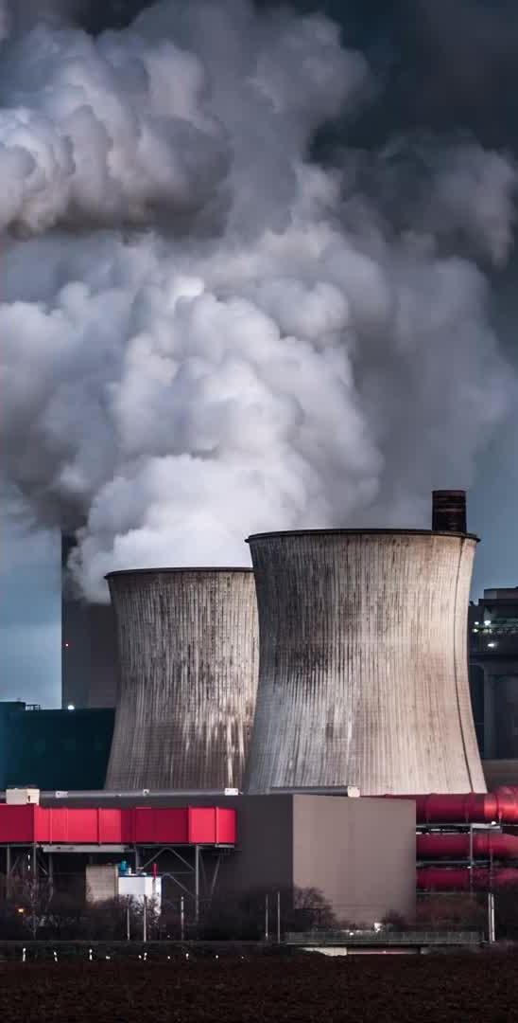



KEY POLICIES
COP21 - THE PARIS AGREEMENT (2015) - AIMS TO SUBSTANTIALLY REDUCE GLOBAL GREENHOUSE GAS EMISSIONS TO LIMIT THE GLOBAL TEMPERATURE INCREASE IN THIS CENTURY TO 2 DEGREES CELSIUS WHILE AIMING FOR 1.5 DEGREES.¹
COP26 (2021) - 190 COUNTRIES AGREED TO PHASE DOWN COAL POWER, RESULTING IN A 76% DECREASE IN PLANNED NEW COAL POWER PLANTS.²
THE IEA PUBLISHED GUIDELINES FOR A NET ZERO EMISSIONS SCENARIO WHICH WOULD ELIMINATE CO EMISSIONS COMPLETELY BY 2050, REQUIRING OVER 3X THE CURRENT WIND GENERATING CAPACITY.³
Notes:
1 - https://www.un.org/en/climatechange/paris-agreement
2 - https://commonslibrary.parliament.uk/what-were-the-outcomes-of-cop26/#:~:text=What%20was%20agreed%3F,also%20made%20during%20the%20conference.
3 - https://www.iea.org/reports/net-zero-by-2050

Slide 6

INFLATION REDUCTION ACT 2022
In August 2022 President Biden signed the Inflation Reduction Act which seeks to reduce carbon emissions by 40 percent by 2030 and provide roughly $400B to fund clean energy projects and private investment in clean energy via tax credits for corporations.⁵
Notes:
5 - https://www.mckinsey.com/industries/public-and-social-sector/our-insights/the-inflation-reduction-act-heres-whats-in-it

Slide 7
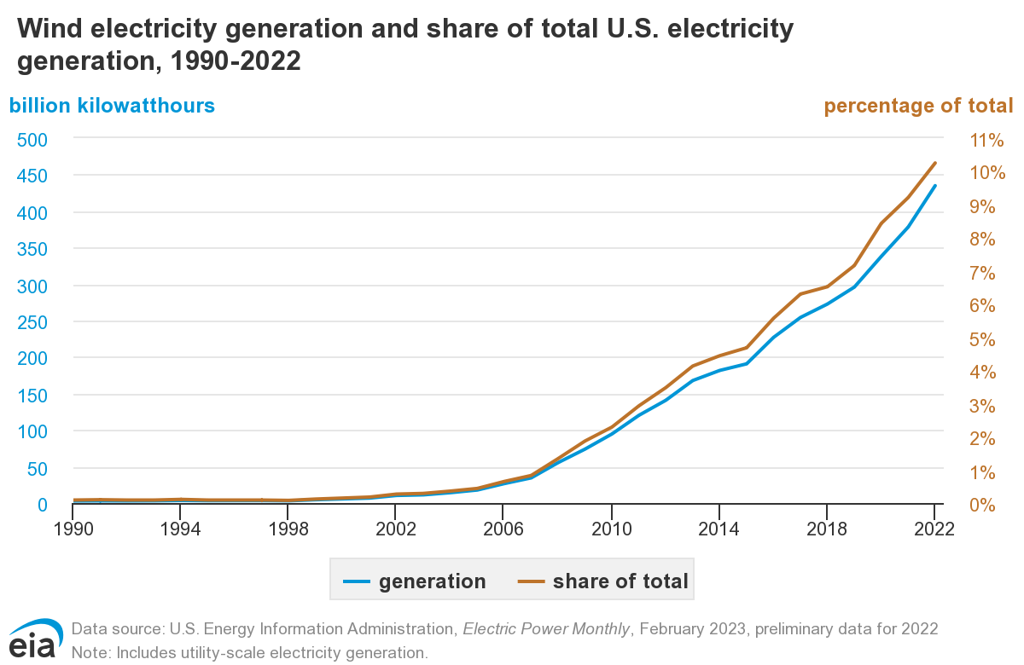
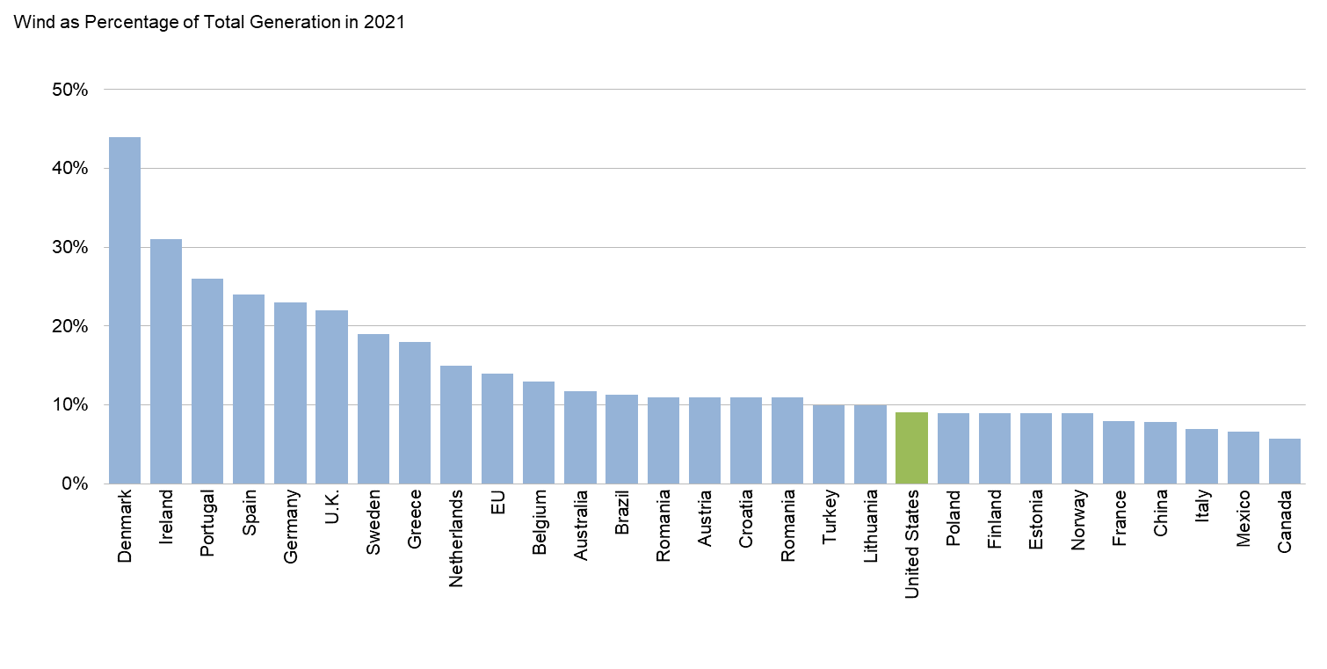
PLACE OF WIND POWER IN THE GLOBAL ENERGY MARKET
^{Fig.1}
CURRENTLY CHINA HAS THE LARGEST CAPACITY INFRASTRUCTURE WITH 338 GW OF CAPACITY AT THE END OF 2021
USA IS SECOND WITH 136 GW OF CAPACITY, FOLLOWED BY GERMANY WITH 65 GW
Fig.2
ALTHOUGH PERCENTAGE OF TOTAL GENERATION MAY BE LOWER, DUE TO CAPACITY, CHINA, EU, AND THE US STILL GENERATE MORE WIND ENERGY THAN OTHER COUNTRIES.⁴
Notes:
https://www.eia.gov/energyexplained/wind/electricity-generation-from-wind.php - fig 1
https://www.energy.gov/sites/default/files/2022-08/land_based_wind_market_report_2202.pdf - Fig 2, bullet 1 & 2
4 - https://www.irena.org/Publications/2023/Mar/Renewable-capacity-statistics-2023 - statistics on wind energy production by country, bullet 3

Slide 8
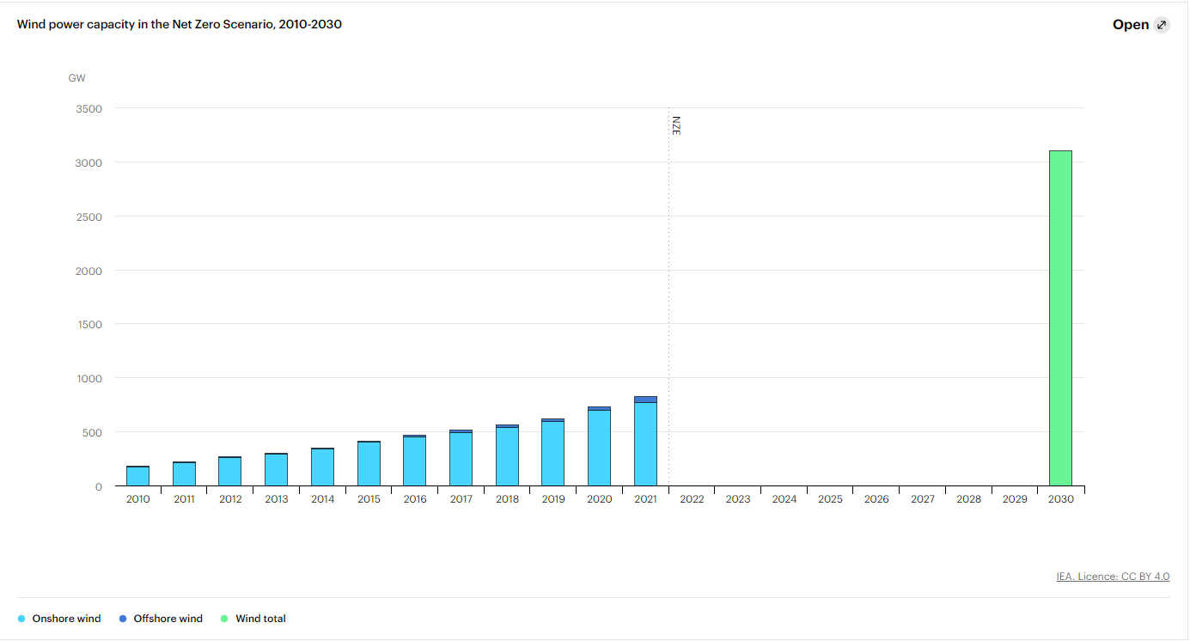
GLOBALLY SINCE 2014...
^{Fig.3}
China has increased its capacity BY 300%
The US has increased its capacity by 213%
The EU has increased its capacity by 157%
(Global capacity statistics)
Notes:
Fig 3. - https://www.iea.org/data-and-statistics/charts/wind-power-generation-in-the-net-zero-scenario-2010-2030-2
Global capacity stats - https://www.irena.org/Publications/2023/Mar/Renewable-capacity-statistics-2023

Slide 9
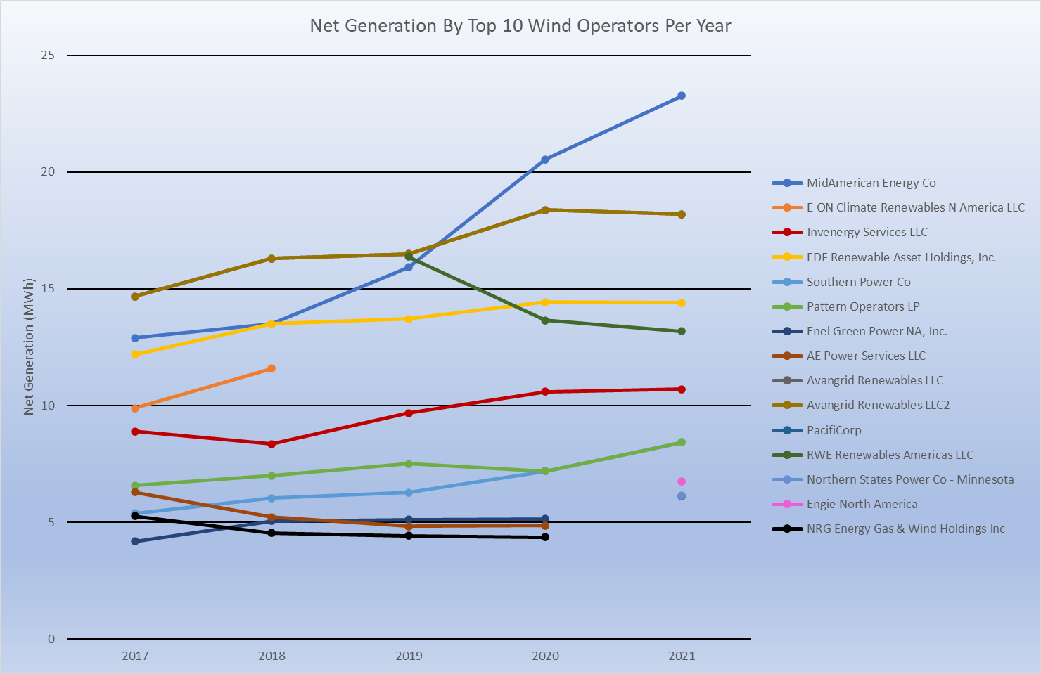
TOP US WIND OPERATORS IN PAST 5 YEARS
^{Fig.4}
We defined wind energy operators in terms of operators who produced the most clean energy using wind powered generators.
Other companies may have produced more energy than those listed here but may have other, less clean means of energy production.
Notes:
Fig 4 - https://www.eia.gov/electricity/data/eia923/

Slide 10
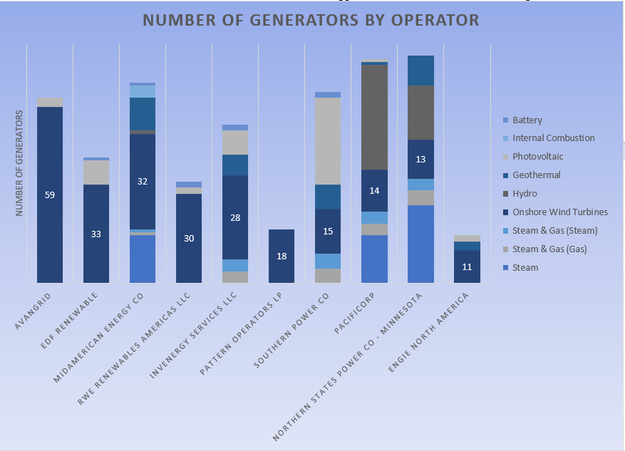
WIND TURBINES PER WIND OPERATOR
^{Fig.5}
Avangrid leads with 59 wind powered generators as of 2021
Midamerican energy co owns 32 generators but produced the most wind energy of these companies in 2021
Notes:
Fig 5. - https://www.eia.gov/electricity/data/eia923/

Slide 11




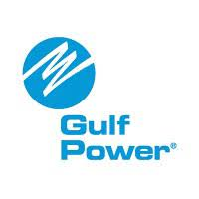
NEXTERA ENERGY, INC. AND ITS SUBSIDIARIES
NextEra Energy, Inc. is one of the largest operators of wind and solar plants in the U.S
In 2021, they owned 40 generators that produced roughly 16 MWh of wind energy.⁶
Generation information is spread out across multiple subsidiaries
Notes:
6 - https://www.nexteraenergy.com/sustainability/environment/renewable-energy.html

Slide 12





UNDERSTANDING WIND TURBINES
HOW LARGE ARE THEY?
WHO ARE THE MANUFACTURERS?
WHAT IS THE CAPACITY?
HOW LARGE ARE THE POWER PLANTS?
ARE THERE ANY MANUFACTURERS THAT REQUIRE MORE MAINTENANCE THAN OTHERS?

Slide 13
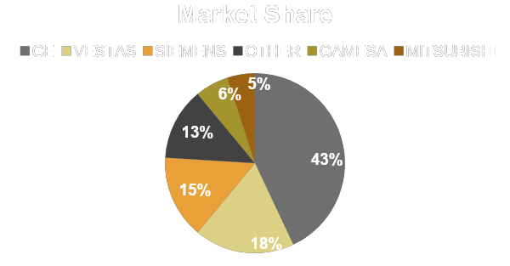
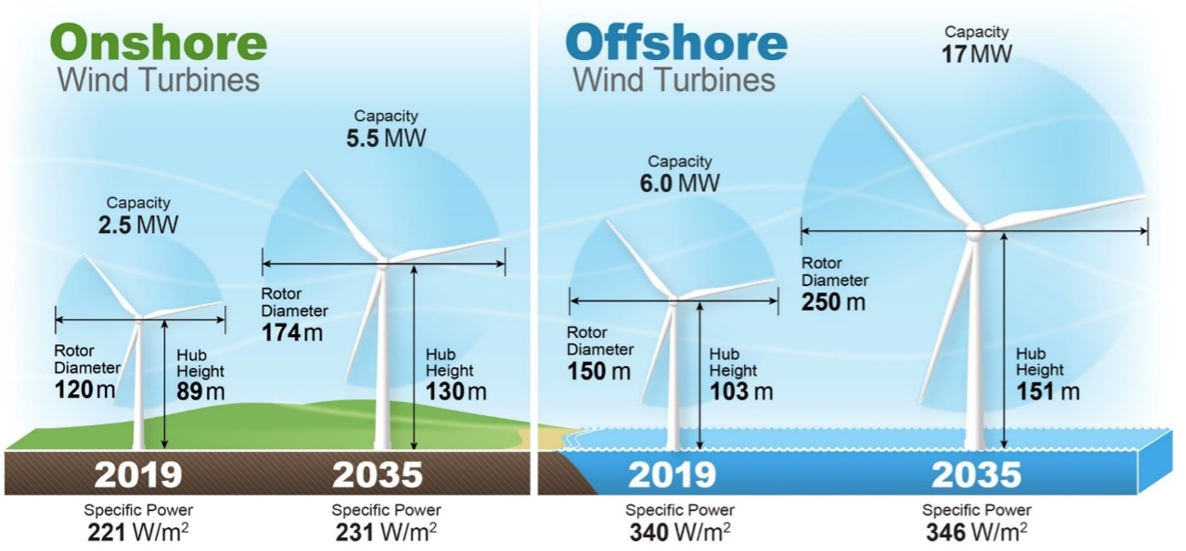
UNDERSTANDING WIND TURBINES
How large are they?
Who are the manufacturers?
^{Fig.6}
^{Fig.7}
Notes:
Fig. 6 -https://www.renewableenergyworld.com/wind-power/wind-power-experts-expect-wind-energy-costs-to-decline-up-to-35-by-2035/
Fig. 7 - https://emp.lbl.gov/sites/default/files/2022_land_based_wind_market_report.pdf

Slide 14
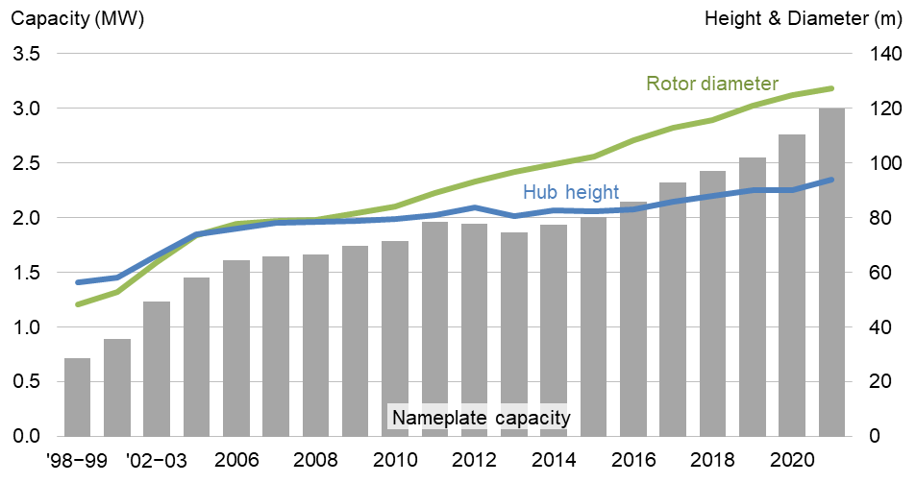
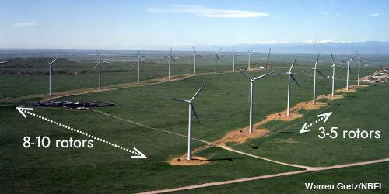
UNDERSTANDING WIND TURBINES
What is the capacity?
How large are the power plants?
Capacity is primarily determined by the length of the blade on the turbine.
Largest utility-scale wind turbine generates around 15mw
Largest wind farm located in texas has 422 wind turbines spread over 47k acres generating 735mw.⁷
Wind farms typically require 30 - 141 acres per megawatt of capacity
Turbines should be spaced in a 5d x 10d grid with d = diameter of rotor.⁸
^{Fig.8}
^{Fig.9}
Notes:
7 - https://www.eia.gov/energyexplained/wind/types-of-wind-turbines.php
8 - https://www.ourworldofenergy.com/vignettes.php?type=wind-power&id=9
Fig 8 - https://emp.lbl.gov/wind-technologies-market-report
Fig 9 - https://www.ourworldofenergy.com/vignettes.php?type=wind-power&id=9

Slide 15
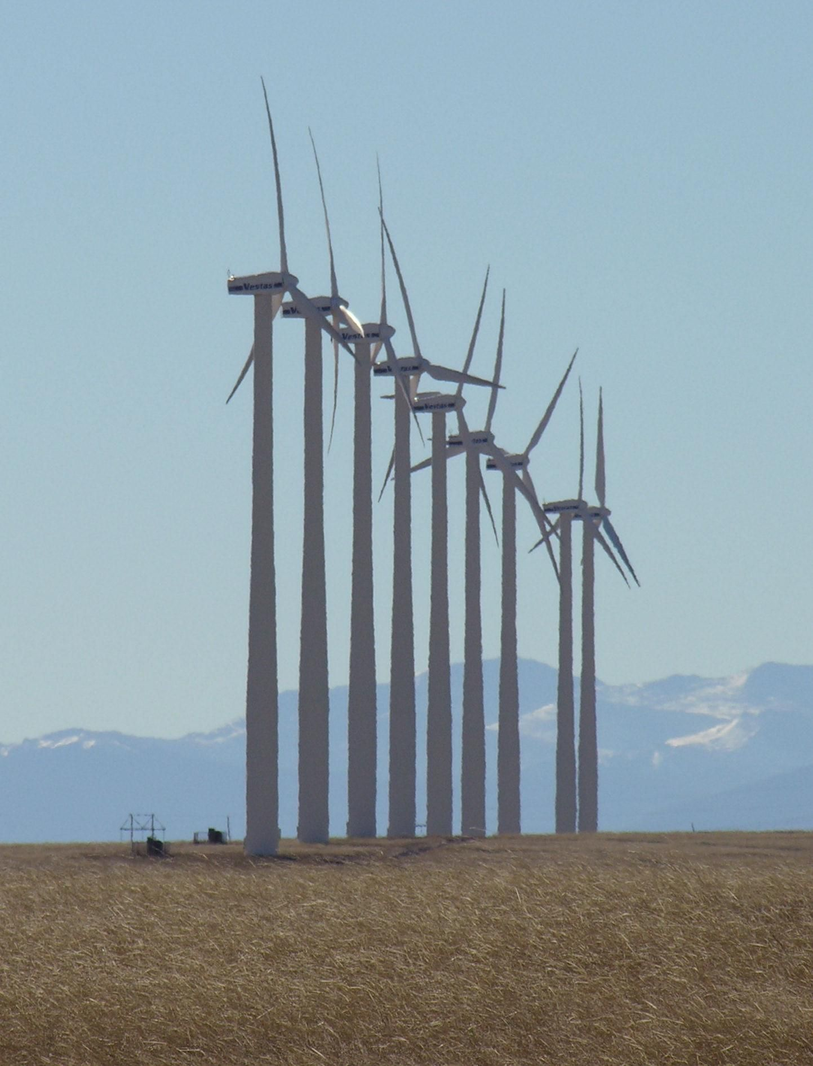
UNDERSTANDING WIND TURBINES
Are there any manufacturers that require more maintenance than others?
Maintenance frequency varies depending on many factors⁹:
the type of turbine
its age
where it’s installed
the amount of wind energy produced
Notes:
9 - https://safetyculture.com/topics/wind-turbine-maintenance/#:~:text=Maintenance%20frequency%20varies%20depending%20on,more%20frequent%20maintenance%20than%20others.

Slide 16
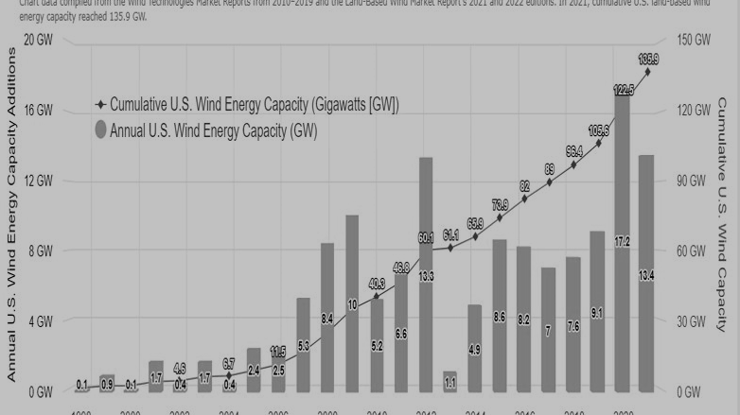
WHAT ARE THE DYNAMICS OF THE WIND TURBINE MARKET IN THE US?
FALLING OFFSHORE WIND PRICES, STATE-LEVEL COMMITMENTS, AND AN UNPRECEDENTED EXPANSION INTO NEW LEASING AREAS DROVE THE U.S. OFFSHORE WIND PIPELINE TO GROW 13.5% OVER THE PREVIOUS YEAR ¹⁰
THE PIPELINE INCLUDES TWO PROJECTS IN OPERATION TOTALING 42 MW, TWO PROJECTS UNDER CONSTRUCTION TOTALING 932 MW, AND 18 PROJECTS IN THE PERMITTING PHASE TOTALING 18,581 MW. ¹⁰
ADDITIONAL 10,000 MEGAWATTS OF LARGE-SCALE BATTERY STORAGE’S ABILITY TO CONTRIBUTE ELECTRICITY TO THE GRID IS LIKELY TO BE INSTALLED BETWEEN 2021 AND 2023 IN THE UNITED STATES—10 TIMES THE TOTAL AMOUNT OF MAXIMUM GENERATION CAPACITY BY ALL SYSTEMS IN 2019.¹¹
Notes:
10 - https://www.energy.gov/eere/wind/articles/offshore-wind-market-report-2022-edition
11 - https://www.eia.gov/analysis/studies/electricity/batterystorage/

Slide 17
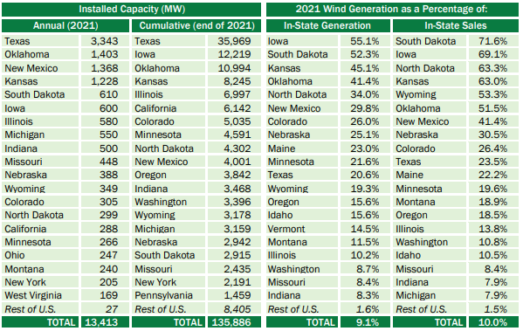
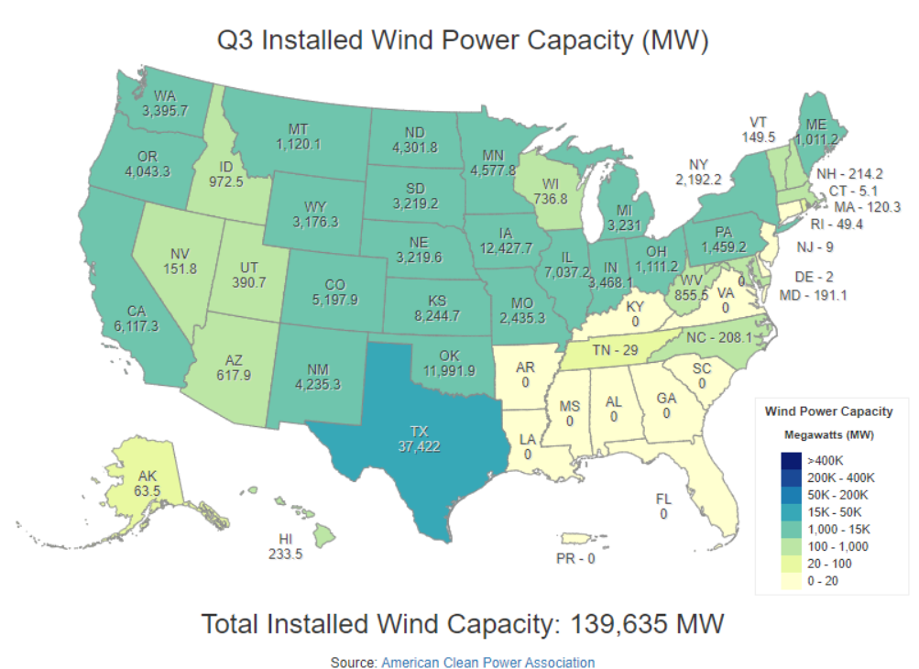
CAPACITY BY STATE
^{Fig.10}
^{Fig.11}
Notes:
Fig 10 - https://emp.lbl.gov/wind-technologies-market-report
Fig 11 - https://windexchange.energy.gov/maps-data/321

Slide 18
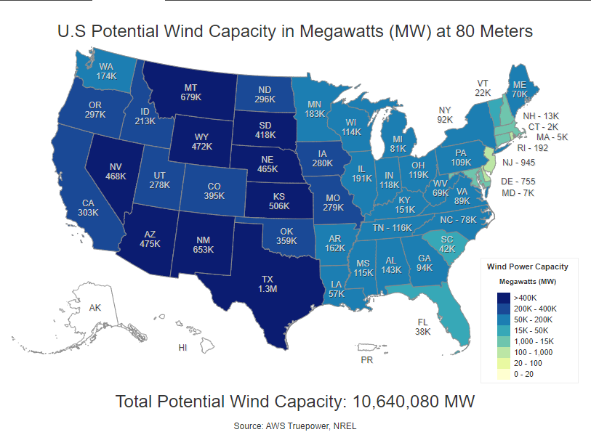
POTENTIAL WIND CAPACITY
^{Fig.12}
Capacity potential is 76 times greater than current installed wind capacity
Notes:
Fig 12 - https://windexchange.energy.gov/maps-data/321

Slide 19
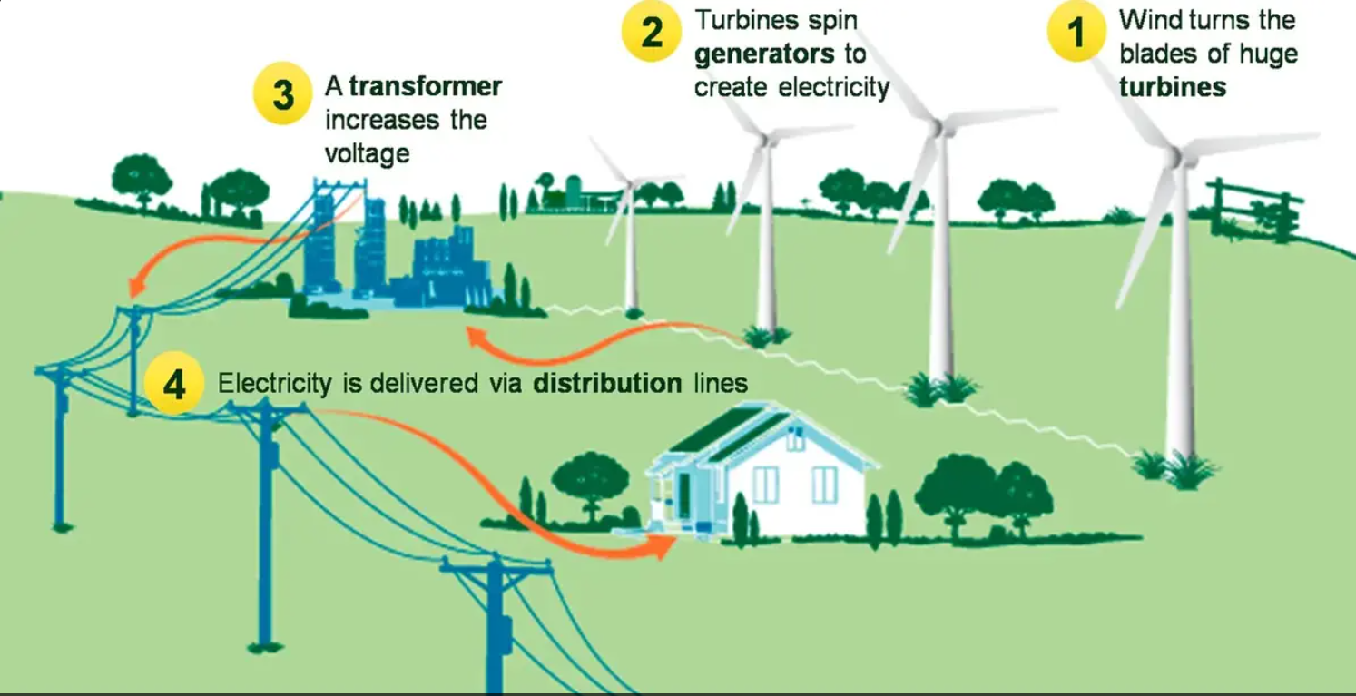




HOW FAR CAN IT TRAVEL AND STILL BE USEFUL^{12, 13}?
THE TURBINES IN A WIND FARM ARE CONNECTED SO THE ELECTRICITY THEY GENERATE CAN TRAVEL FROM THE WIND FARM TO THE POWER GRID.
ONCE WIND ENERGY IS ON THE MAIN POWER GRID, ELECTRIC UTILITIES OR POWER OPERATORS WILL SEND THE ELECTRICITY TO WHERE PEOPLE NEED IT.
SUB-TRANSMISSION LINES COLLECT ELECTRICITY GENERATED AT THE WIND PROJECT AND TRANSPORT IT TO LARGER TRANSMISSION LINES, WHERE THE ELECTRICITY CAN TRAVEL ACROSS LONG DISTANCES TO THE LOCATIONS WHERE IT IS NEEDED.
FINALLY, SMALLER DISTRIBUTION LINES DELIVER ELECTRICITY DIRECTLY TO YOUR TOWN, HOME, OR BUSINESS.
Notes:
12 - https://cleanpower.org/facts/wind-power/
13 - https://sciencing.com/electricity-move-wind-turbine-businesses-communities-buy-it-21904.html

Slide 20



ENVIRONMENTAL ISSUES WITH BUILDING WIND TURBINES¹⁴
LAND
BAT AND BIRD
MARINE LIFE
LAND USE (30 - 141 ACRES PER MEGAWATT OF POWER OUTPUT CAPACITY)
LESS THAN 1 ACRE PER MEGAWATT IS DISTURBED PERMANENTLY
LESS THEN 3.5 ACRES PER MEGAWATT ARE DISTURBED TEMPORARILY DURING CONSTRUCTION
BAT AND BIRD DEATHS
BIRD DEATHS ASSOCIATED WITH OFFSHORE WIND ARE MINIMAL
BATS FLY AT LOW WINDS SO TURBINES ARE TURNED OFF AT LOW WIND WHICH HELP ELIMINATE HALF OF DEATHS OCCURRING.
WIND FARMS LOCATED OFFSHORE WILL ALSO IMPACT FISH AND OTHER MARINE WILDLIFE
MAY INCREASE FISH POPULATIONS BY ACTING AS ARTIFICIAL REEFS
Notes:
14 - https://www.eia.gov/energyexplained/wind/wind-energy-and-the-environment.php#:~:text=Wind%20turbines%20have%20some%20negative%20effects%20on%20the%20environment&text=Birds%20and%20bats%20can%20be,by%20other%20human%2Drelated%20impacts.

Slide 21



ENVIRONMENTAL ISSUES WITH BUILDING WIND TURBINES¹⁵
SOUND AND VISUAL IMPACT
SOUND GENERATED BY WIND TURBINES IS AERODYNAMIC
WATER USE
NO WATER IMPACT ASSOCIATED WITH THE OPERATION OF WIND TURBINES
NO GLOBAL WARMING EMISSIONS ASSOCIATED WITH OPERATING WIND TURBINES
MOST ESTIMATES OF WIND TURBINE LIFE-CYCLE GLOBAL WARMING EMISSION ARE BETWEEN .02 - .04 POUNDS OF CARBON DIOXIDE EQUIVALENT PER KILOWATT-HOUR
THE FEDERAL AVIATION ADMINISTRATION (FAA) REQUIRES THAT LARGE WIND TURBINES, (ALL STRUCTURES OVER 200 FEET HIGH) HAVE WHITE OR RED LIGHTS FOR AVIATION SAFETY.
DAYTIME LIGHTING IS UNNECESSARY AS LONG AS THE TURBINES ARE PAINTED WHITE
Notes:
15 - https://www.ucsusa.org/resources/environmental-impacts-wind-power

Slide 22



AVERAGE WIND SPEEDS OVERLAID WITH WIND TURBINES ACROSS USA
ONSHORE TURBINES ACROSS USA
EAST COAST OFFSHORE TURBINES
WEST COAST OFFSHORE TURBINES

Slide 23
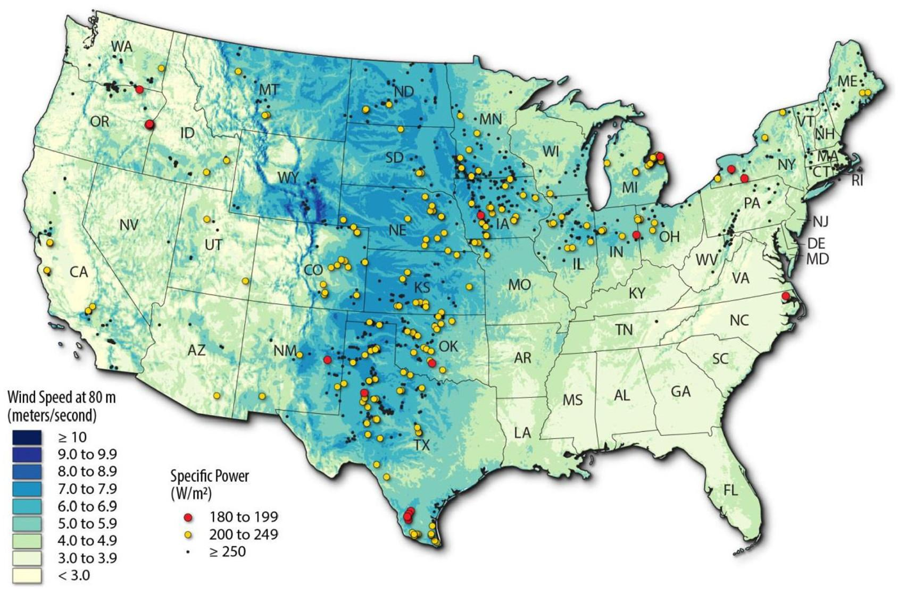
ONSHORE TURBINES ACROSS USA
^{Fig.13}
Notes:
Fig 13 - https://windexchange.energy.gov/maps-data

Slide 24
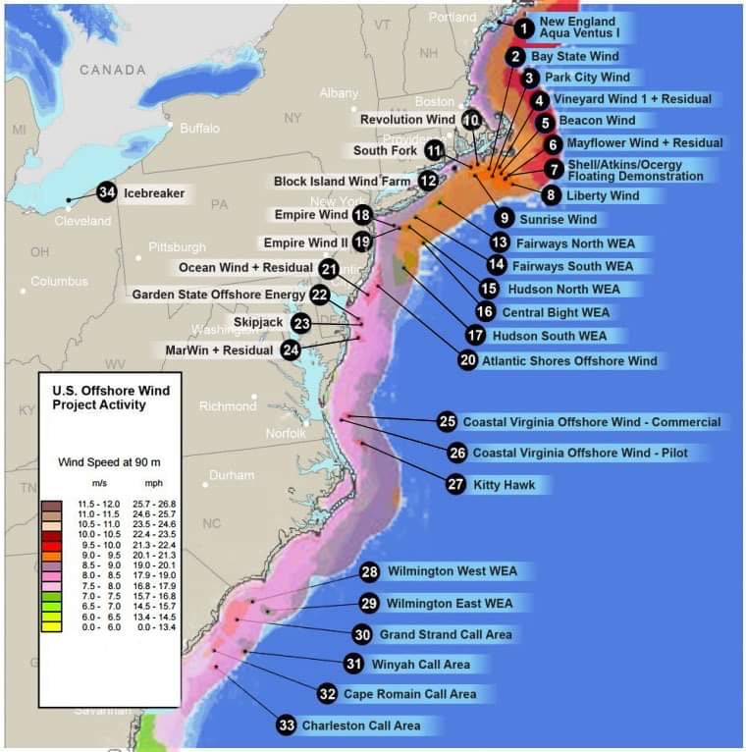
EAST COAST OFFSHORE TURBINES
^{Fig.14}
Notes:
Fig 14 - https://windexchange.energy.gov/maps-data

Slide 25
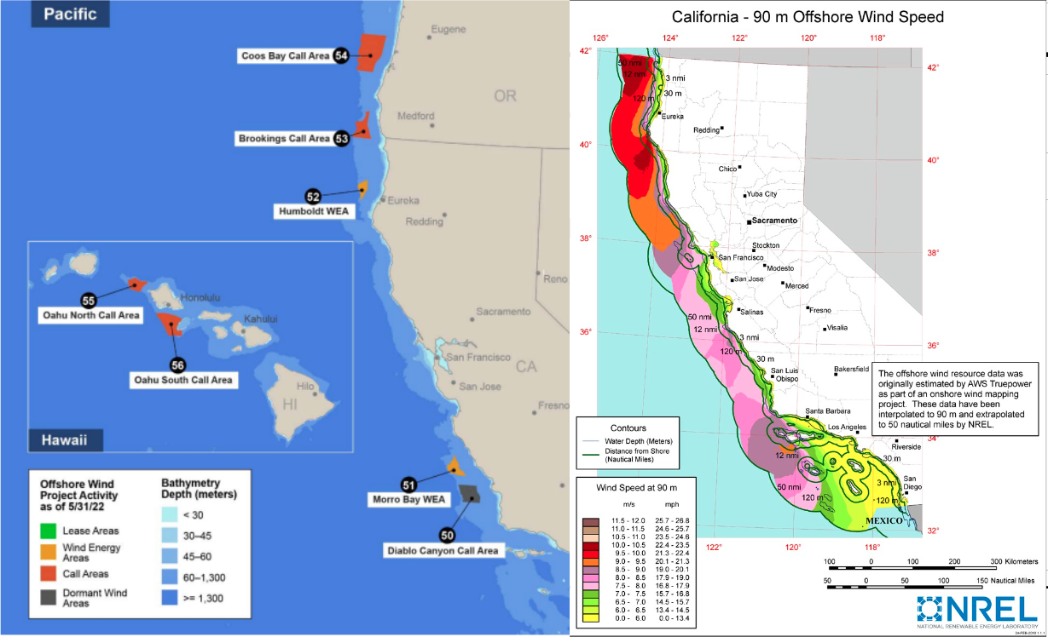
WEST COAST OFFSHORE TURBINES
^{Fig.15}
Notes:
Fig 15 - https://windexchange.energy.gov/maps-data

Slide 26



INVESTING IN WIND TURBINE OPERATORS
BEST VALUE WIND ENERGY STOCKS
FASTEST GROWING WIND ENERGY STOCKS
WIND ENERGY STOCKS WITH THE MOST MOMENTUM

Slide 27
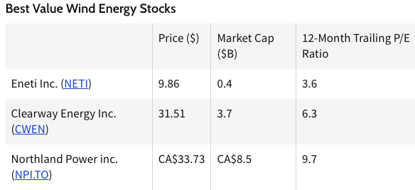
BEST VALUE WIND ENERGY STOCKS¹⁶
^{Fig.16}
Eneti inc: has reported its 4th qtr earnings ($12m in net income) more than doubling compared to q4 2021.
Clearway energy inc: operates wind, solar, and natural gas
Northland power inc: operates wind, natural gas, & solar. Just secured largest battery energy storage project in canada.
Notes:
Fig 16 - https://www.investopedia.com/top-wind-energy-stocks-q2-2023-7484579
16 - https://www.investopedia.com/top-wind-energy-stocks-q2-2023-7484579

Slide 28
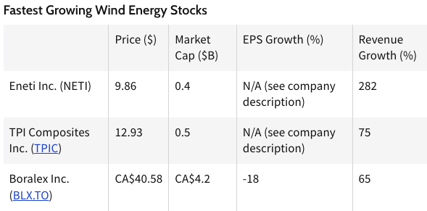
FASTEST GROWING WIND ENERGY STOCKS¹⁷
eneti inc: no growth figure. Diluted eps in q4 2022 was $.32
TPI Composites Inc: no growth figure. Reported negative eps in the most recent qtr
Boralex inc: announced in dec. that it acquired edf renewables’ interest in 5 operating wind farms in new Mexico & Texas.
^{Fig.17}
Notes:
17 - https://www.investopedia.com/top-wind-energy-stocks-q2-2023-7484579
Fig 17 - https://www.investopedia.com/top-wind-energy-stocks-q2-2023-7484579

Slide 29
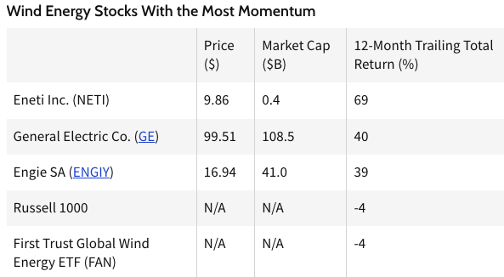
WIND ENERGY STOCKS WITH THE MOST MOMENTUM¹⁸
^{Fig.18}
Eneti Inc: highest return percentage
General Electric Co.: stock priced has doubled since Oct. of last year. *partly due to its healthcare business.
Engie SA: France-based company operating in wind, hydroelectric, & solar
Notes:
18 - https://www.investopedia.com/top-wind-energy-stocks-q2-2023-7484579
Fig 18 - https://www.investopedia.com/top-wind-energy-stocks-q2-2023-7484579

Slide 30
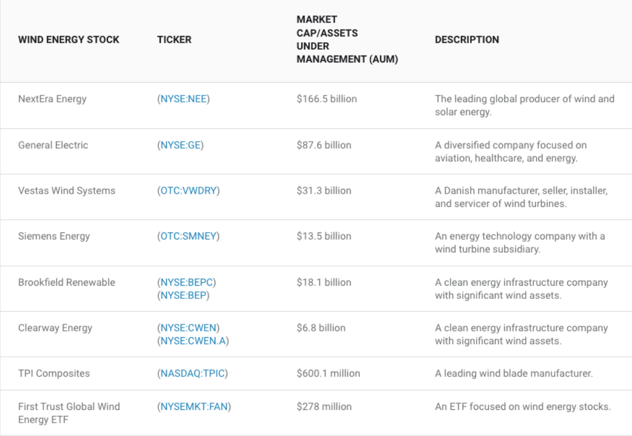
PROFITABILITY¹⁹
After our detailed review, we have concluded, Clearway Energy being the best choice for an investment as it gives you the best “bang for your buck”.
^{Fig.19}
Notes:
19 - https://www.fool.com/investing/stock-market/market-sectors/energy/wind-energy-stocks/

Slide 31
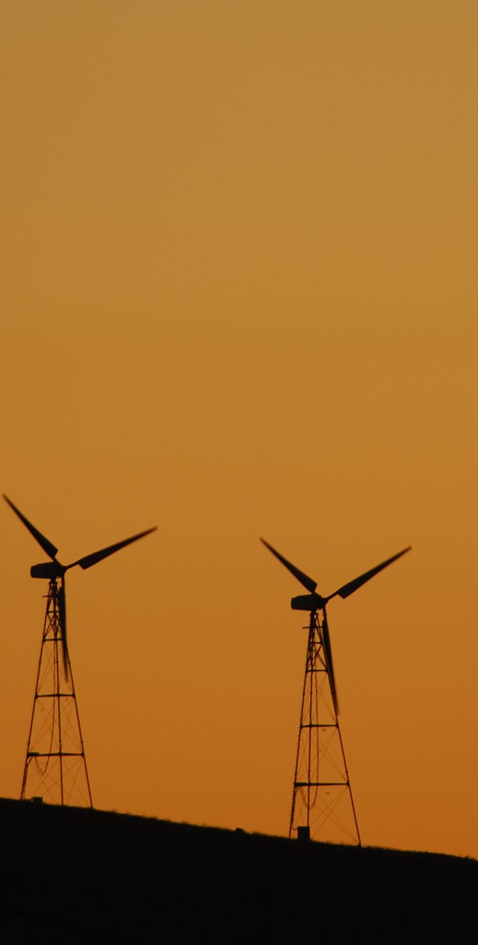
REFERENCES
1 - https://www.un.org/en/climatechange/paris-agreement
2 - https://commonslibrary.parliament.uk/what-were-the-outcomes-of-cop26/#:~:text=What%20was%20agreed%3F,also%20made%20during%20the%20conference
3 - https://www.iea.org/reports/net-zero-by-2050
4 - https://www.irena.org/Publications/2023/Mar/Renewable-capacity-statistics-2023
5 - https://www.mckinsey.com/industries/public-and-social-sector/our-insights/the-inflation-reduction-act-heres-whats-in-it
Global capacity stats - https://www.irena.org/Publications/2023/Mar/Renewable-capacity-statistics-2023
6 - https://www.nexteraenergy.com/sustainability/environment/renewable-energy.html
7 - https://www.eia.gov/energyexplained/wind/types-of-wind-turbines.php
8 - https://www.ourworldofenergy.com/vignettes.php?type=wind-power&id=9

Slide 32
REFERENCES CONT.
9 - https://safetyculture.com/topics/wind-turbine-maintenance/#:~:text=Maintenance%20frequency%20varies%20depending%20on,more%20frequent%20maintenance%20than%20others
10 - https://www.energy.gov/eere/wind/articles/offshore-wind-market-report-2022-edition
11 - https://www.eia.gov/analysis/studies/electricity/batterystorage/
12 - https://cleanpower.org/facts/wind-power/
13 - https://sciencing.com/electricity-move-wind-turbine-businesses-communities-buy-it-21904.html
14 - https://www.eia.gov/energyexplained/wind/wind-energy-and-the-environment.php#:~:text=Wind%20turbines%20have%20some%20negative%20effects%20on%20the%20environment&text=Birds%20and%20bats%20can%20be,by%20other%20human%2Drelated%20impacts
15 - https://www.ucsusa.org/resources/environmental-impacts-wind-power
16, 17 ,18 - https://www.investopedia.com/top-wind-energy-stocks-q2-2023-7484579
19 - https://www.fool.com/investing/stock-market/market-sectors/energy/wind-energy-stocks/

Slide 33
FIGURES
Fig 1 - https://www.eia.gov/energyexplained/wind/electricity-generation-from-wind.php
Fig 2 - https://www.energy.gov/sites/default/files/2022-08/land_based_wind_market_report_2202.pdf
Fig 3 - https://www.iea.org/data-and-statistics/charts/wind-power-generation-in-the-net-zero-scenario-2010-2030-2
Fig 4, 5 - https://www.eia.gov/electricity/data/eia923/
Fig. 6 - https://www.renewableenergyworld.com/wind-power/wind-power-experts-expect-wind-energy-costs-to-decline-up-to-35-by-2035/
Fig. 7 - https://emp.lbl.gov/sites/default/files/2022_land_based_wind_market_report.pdf
Fig 8 - https://emp.lbl.gov/wind-technologies-market-report
Fig 9 - https://www.ourworldofenergy.com/vignettes.php?type=wind-power&id=9
Fig 10 - https://emp.lbl.gov/wind-technologies-market-report

Slide 34
FIGURES CONT.
Fig 11, 12 - https://windexchange.energy.gov/maps-data/321
Fig 13, 14, 15 - https://windexchange.energy.gov/maps-data
Fig 16, 17 ,18 - https://www.investopedia.com/top-wind-energy-stocks-q2-2023-7484579
Fig 19 - https://www.fool.com/investing/stock-market/market-sectors/energy/wind-energy-stocks/

